Slide 1
Mining Large Graphs: Patterns, Anomalies, and Fraud Detection
Christos Faloutsos
CMU

Slide 2
To Leman, from christos
Feel free to ignore / modify at will!
FYI, I marked the starting point of each paper with a red-background slide

Slide 3
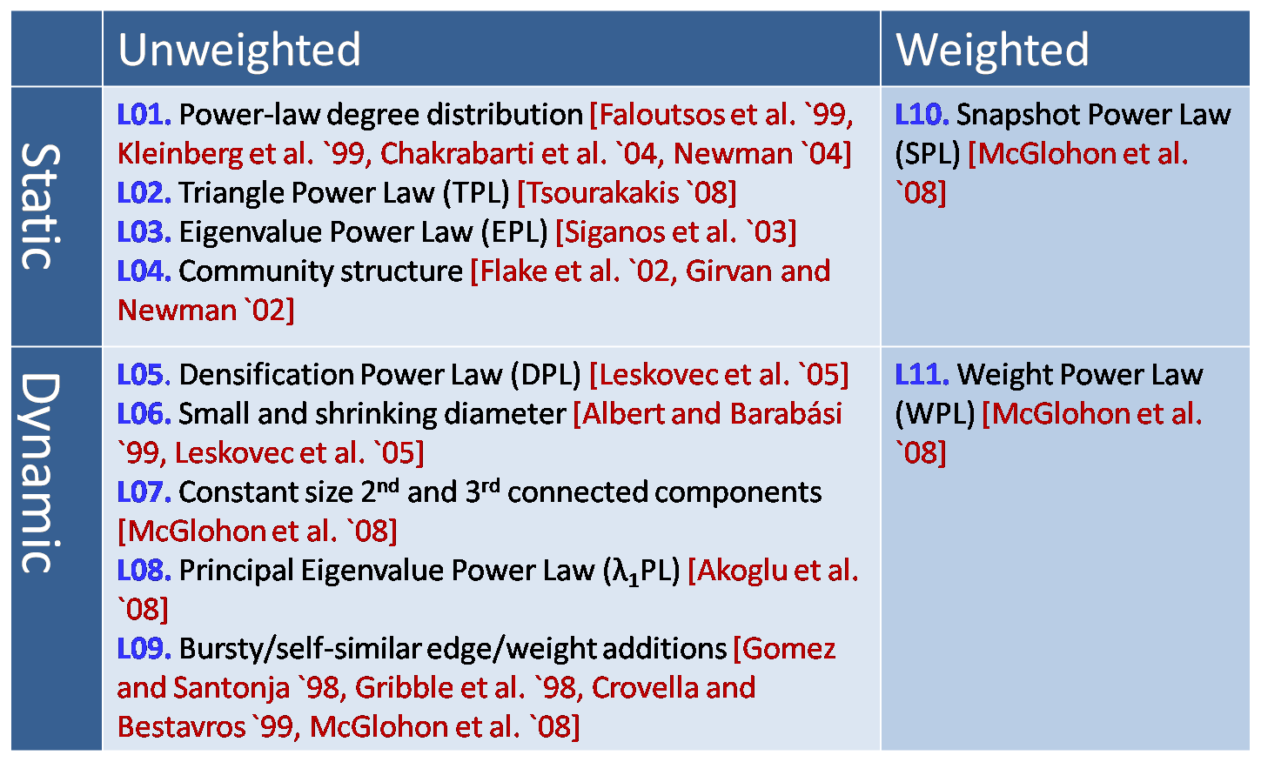
MORE Graph Patterns
✔
✔
✔
RTG: A Recursive Realistic Graph Generator using Random Typing Leman Akoglu and Christos Faloutsos. PKDD’09.

Slide 4
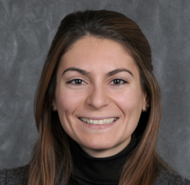
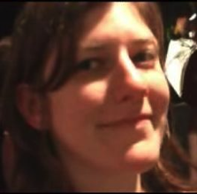
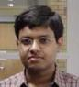

MORE Graph Patterns
Mary McGlohon, Leman Akoglu, Christos Faloutsos. Statistical Properties of Social Networks. in "Social Network Data Analytics” (Ed.: Charu Aggarwal)
Deepayan Chakrabarti and Christos Faloutsos, Graph Mining: Laws, Tools, and Case Studies Oct. 2012, Morgan Claypool.

Slide 5
CopyCatch

Slide 6
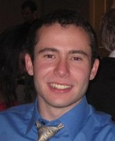
Fraud
Given
Who ‘likes’ what page, and when
Find
Suspicious users and suspicious products
CopyCatch: Stopping Group Attacks by Spotting Lockstep Behavior in Social Networks, Alex Beutel, Wanhong Xu, Venkatesan Guruswami, Christopher Palow, Christos Faloutsos WWW, 2013.

Slide 7


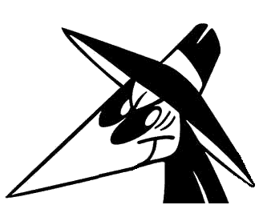




Fraud
Given
Who ‘likes’ what page, and when
Find
Suspicious users and suspicious products
Likes
CopyCatch: Stopping Group Attacks by Spotting Lockstep Behavior in Social Networks, Alex Beutel, Wanhong Xu, Venkatesan Guruswami, Christopher Palow, Christos Faloutsos WWW, 2013.

Slide 8
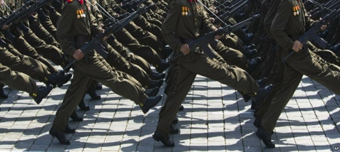
Graph Patterns and Lockstep Behavior
Our intuition
Lockstep behavior: Same Likes, same time
Likes
Notes:
Warming Hearts of Rockland
Beast – 1.5 million followers
Not real bad pages or data

Slide 9
Graph Patterns and Lockstep Behavior
Our intuition
Lockstep behavior: Same Likes, same time
Likes
Notes:
Warming Hearts of Rockland
Beast – 1.5 million followers
Not real bad pages or data

Slide 10
Graph Patterns and Lockstep Behavior
Our intuition
Lockstep behavior: Same Likes, same time
Likes
Suspicious Lockstep Behavior
Notes:
Warming Hearts of Rockland
Beast – 1.5 million followers
Not real bad pages or data

Slide 11





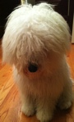
MapReduce Overview
Use Hadoop to search for many clusters in parallel:
Start with randomly seed
Update set of Pages and center Like times for each cluster
Repeat until convergence
Likes

Slide 12
Deployment at Facebook
CopyCatch runs regularly (along with many other security mechanisms, and a large Site Integrity team)
3 months of CopyCatch @ Facebook
#users
caught
time

Slide 13
Deployment at Facebook
Fake acct
Manually labeled 22 randomly selected
clusters from February 2013

Slide 14
Deployment at Facebook
Fake acct
Most clusters (77%) come from
real but compromised users
Manually labeled 22 randomly selected
clusters from February 2013

Slide 15
Fbox

Slide 16
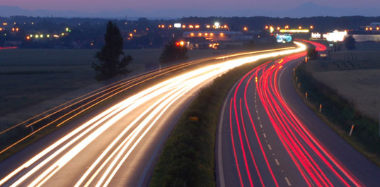
Roadmap
Introduction – Motivation
Part#1: Patterns in graphs
Patterns
Anomaly / fraud detection
CopyCatch
Spectral methods (‘fBox’)
Belief Propagation
Part#2: time-evolving graphs; tensors
Conclusions

Slide 17

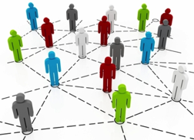

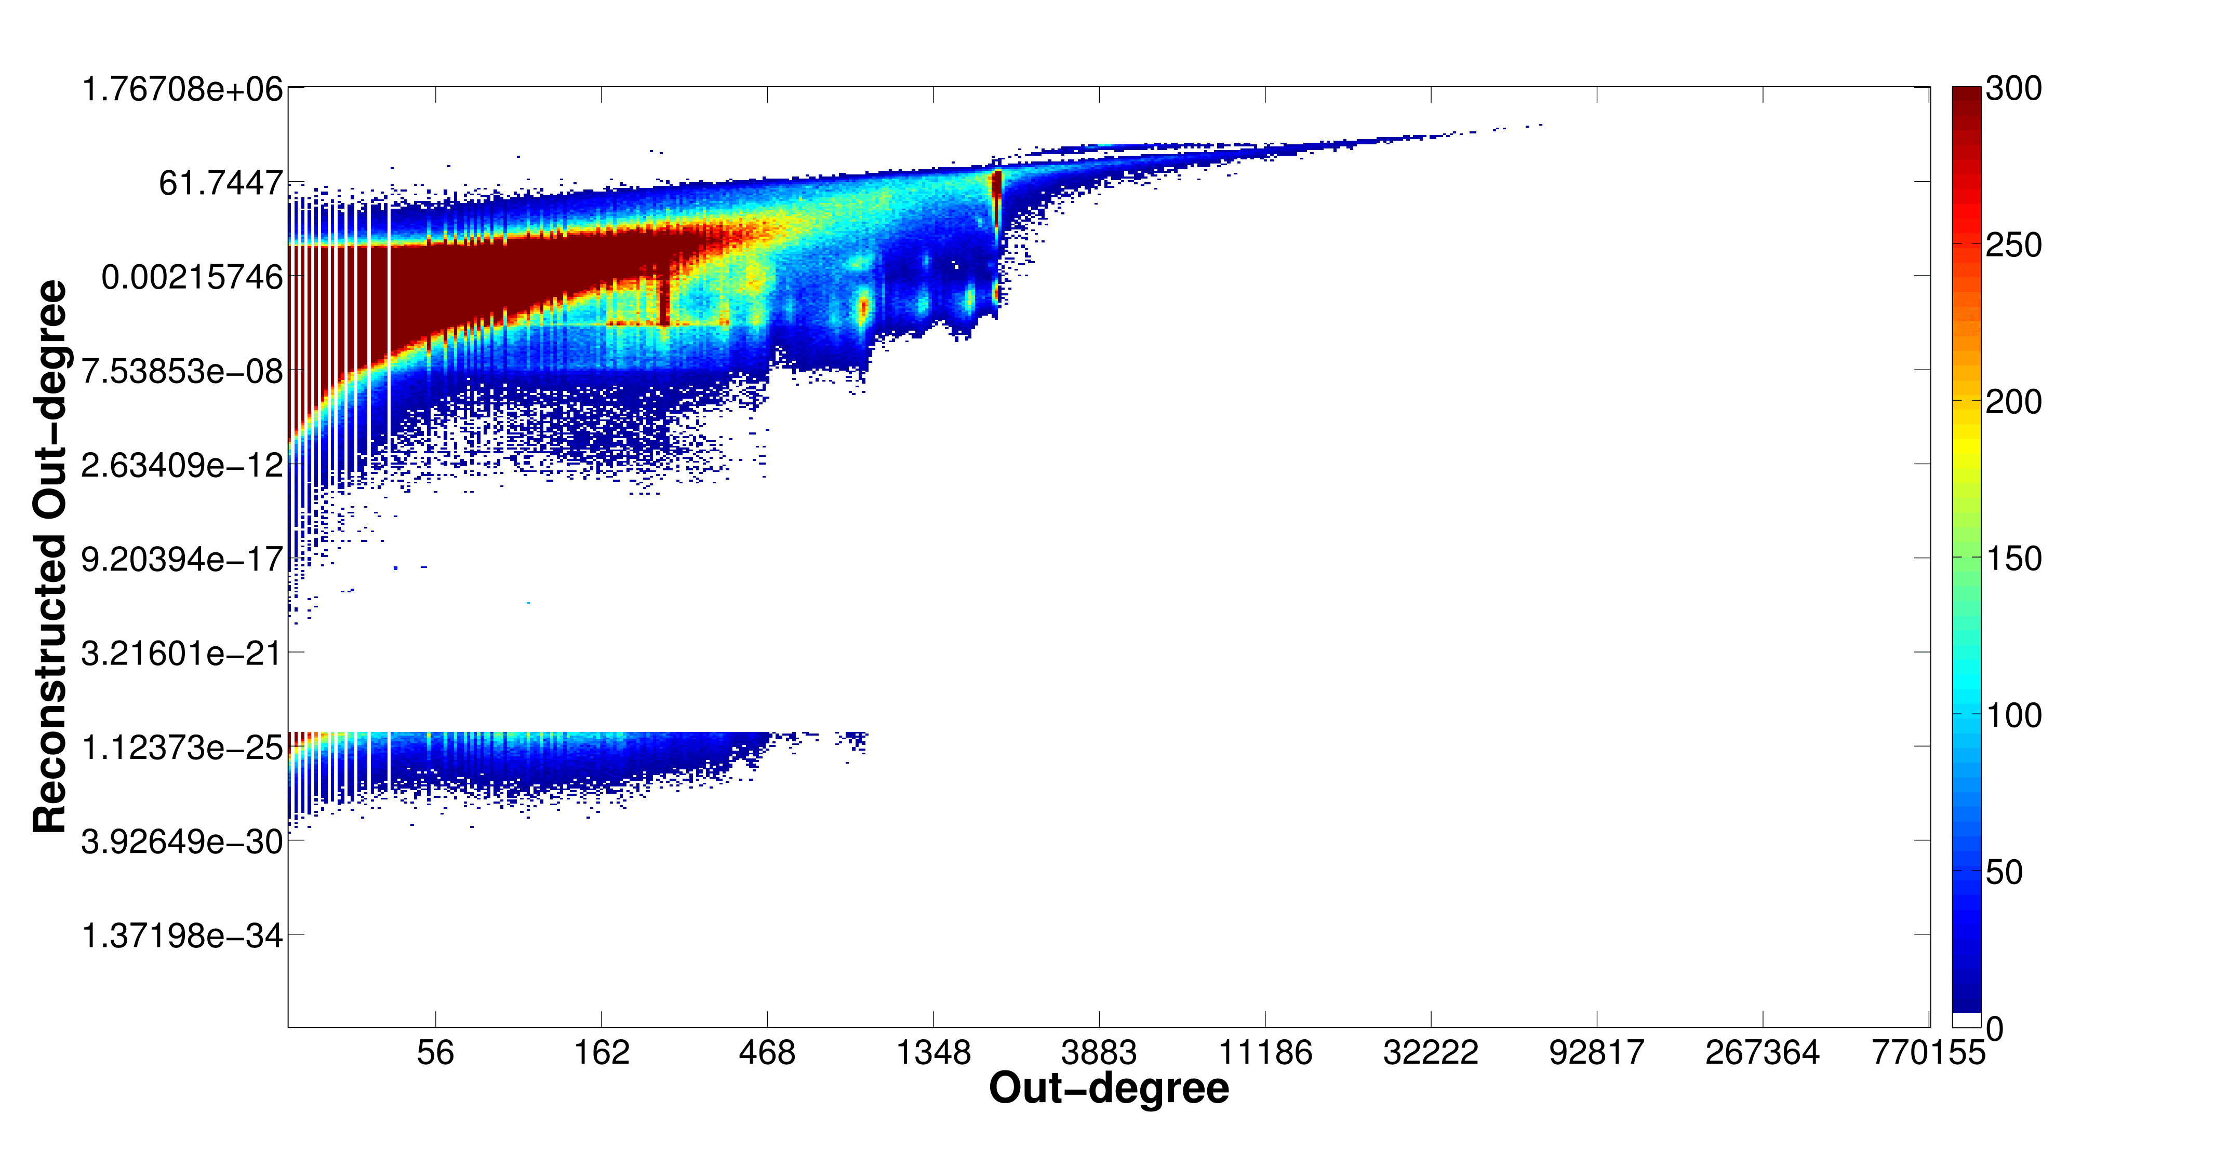
Problem: Social Network Link Fraud
Target: find “stealthy” attackers missed by other algorithms
Clique
41.7M nodes
1.5B edges
Bipartite
core

Slide 18
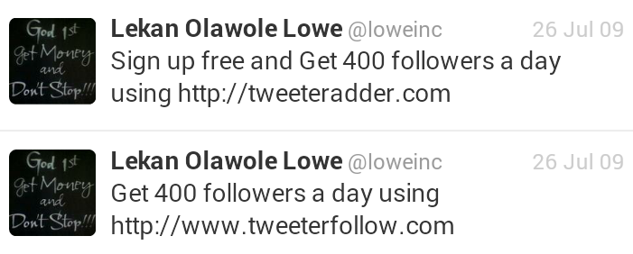

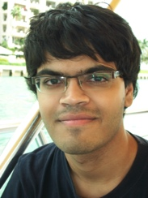
Problem: Social Network Link Fraud
Target: find “stealthy” attackers missed by other algorithms
Takeaway: use reconstruction error between true/latent representation!
Neil Shah, Alex Beutel, Brian Gallagher and Christos Faloutsos. Spotting Suspicious Link Behavior with fBox: An Adversarial Perspective. ICDM 2014, Shenzhen, China.
Notes:
Social networks with popularity incentives are plagued by the problem of link fraud, involving “bot” accounts falsely increasing popularity of a person or organization. These bots form cliques and bipartite cores in the graph structure. Several works have targeted the detection of large cases of fraud using spectral approaches like SVD, but fail to detect smaller, stealthier attacks due to computational restrictions on latent feature computation. Our approach, called fBox, leverages the reconstruction or projection error between latent, SVD representation and original graph representation to find anomalous bot accounts with high precision.

Slide 19
Roadmap
Introduction – Motivation
Part#1: Patterns in graphs
Patterns
Anomaly / fraud detection
CopyCatch
Spectral methods (‘fBox’, suspiciousness)
Belief Propagation
Part#2: time-evolving graphs; tensors
Conclusions

Slide 20
CrossSpot

Slide 21
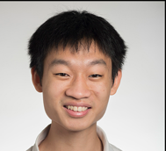

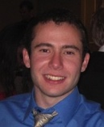

Suspicious Patterns in Event Data
?
2-modes
?
?
n-modes
A General Suspiciousness Metric for Dense Blocks in Multimodal Data, Meng Jiang, Alex Beutel, Peng Cui, Bryan Hooi, Shiqiang Yang, and Christos Faloutsos, ICDM, 2015.

Slide 22
Suspicious Patterns in Event Data
ICDM 2015
Which is more suspicious?
20,000 Users
Retweeting same 20 tweets
6 times each
All in 10 hours
225 Users
Retweeting same 1 tweet
15 times each
All in 3 hours
All from 2 IP addresses
vs.
Answer: volume * D_{KL}(p|| p_{background})

Slide 23

Suspicious Patterns in Event Data
ICDM 2015
Retweeting: “Galaxy Note Dream Project: Happy Happy Life Traveling the World”

Slide 24
Spectral
methods

Slide 25
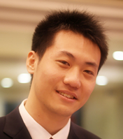
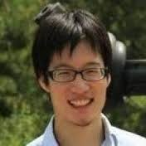
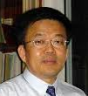

Inferring Strange Behavior from Connectivity Pattern in Social Networks PAKDD’14
Meng Jiang, Peng Cui, Shiqiang Yang (Tsinghua)
Alex Beutel, Christos Faloutsos (CMU)

Slide 26
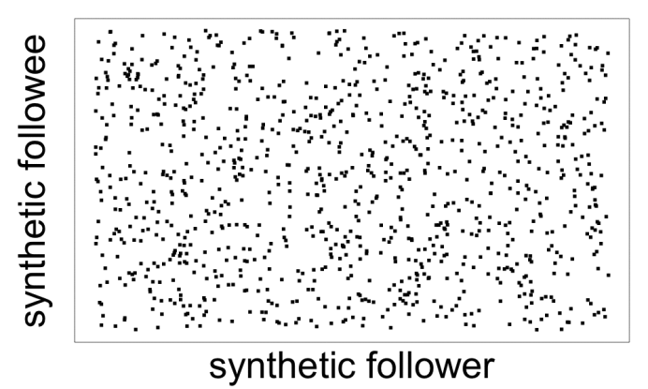
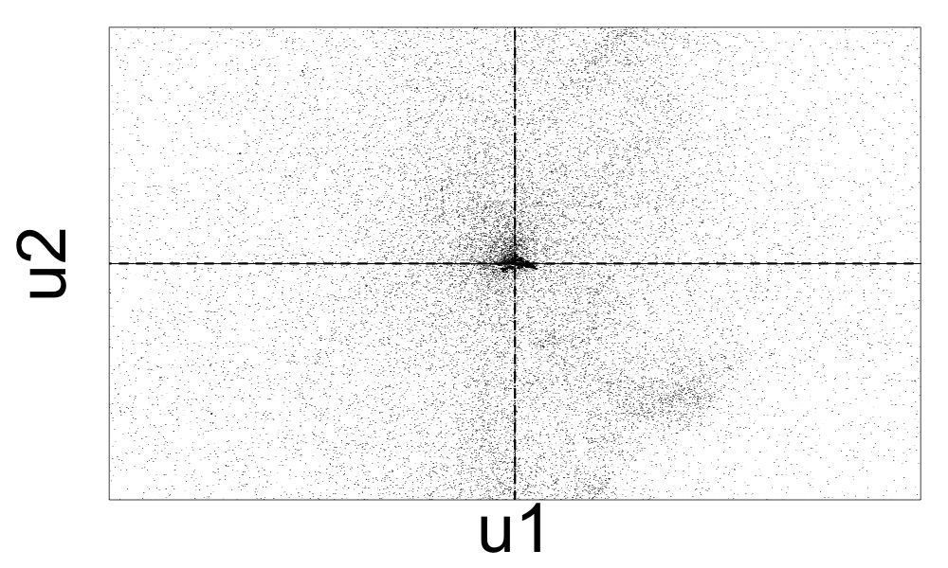
Lockstep and Spectral Subspace Plot
Case #0: No lockstep behavior in random power law graph of 1M nodes, 3M edges
Random “Scatter”
Adjacency Matrix
Spectral Subspace Plot
+
+

Slide 27
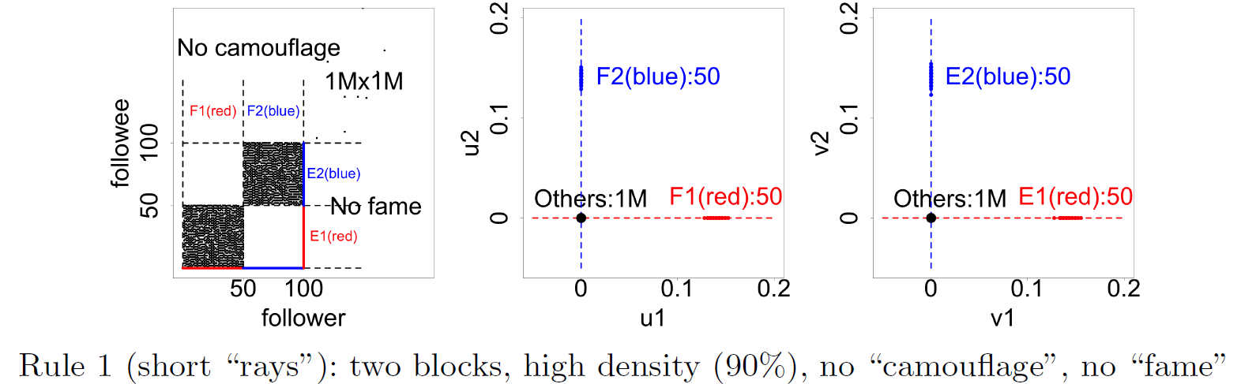
Lockstep and Spectral Subspace Plot
Case #1: non-overlapping lockstep
“Blocks” “Rays”
Adjacency Matrix
Spectral Subspace Plot

Slide 28
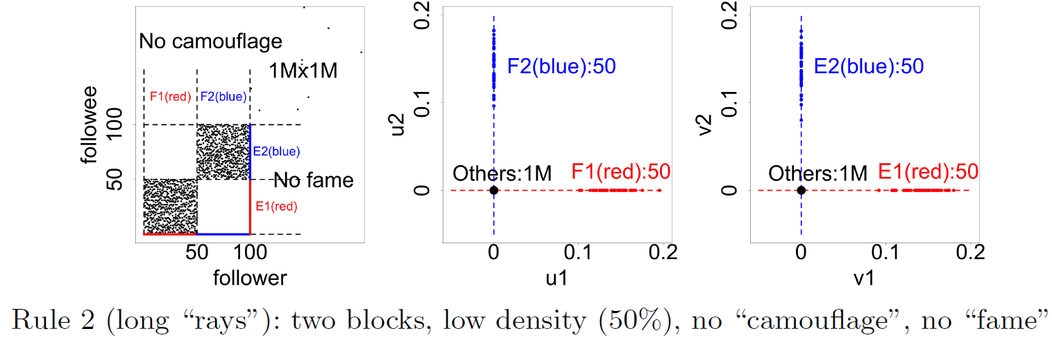
Lockstep and Spectral Subspace Plot
Case #2: non-overlapping lockstep
“Blocks; low density” Elongation
Adjacency Matrix
Spectral Subspace Plot

Slide 29
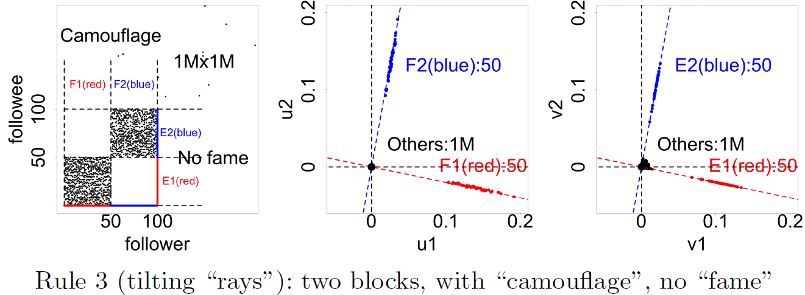
Lockstep and Spectral Subspace Plot
Case #3: non-overlapping lockstep
“Camouflage” (or “Fame”) Tilting “Rays”
Adjacency Matrix
Spectral Subspace Plot

Slide 30
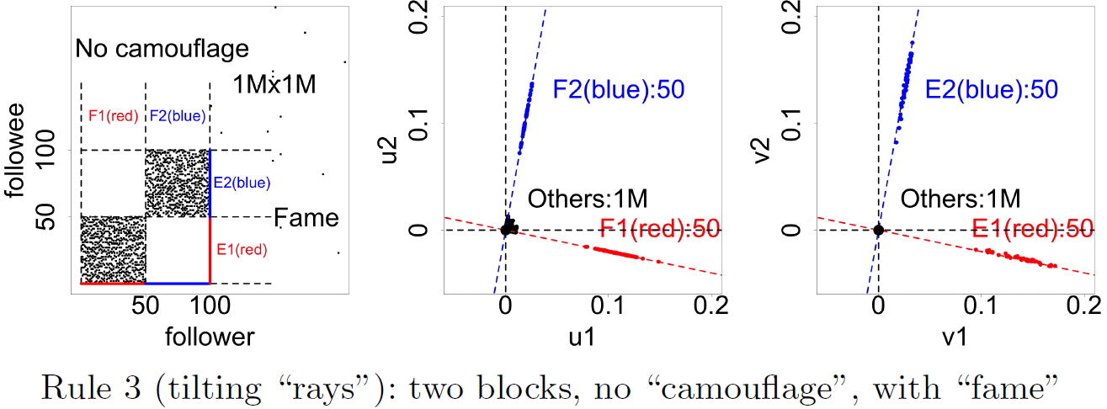
Lockstep and Spectral Subspace Plot
Case #3: non-overlapping lockstep
“Camouflage” (or “Fame”) Tilting “Rays”
Adjacency Matrix
Spectral Subspace Plot

Slide 31
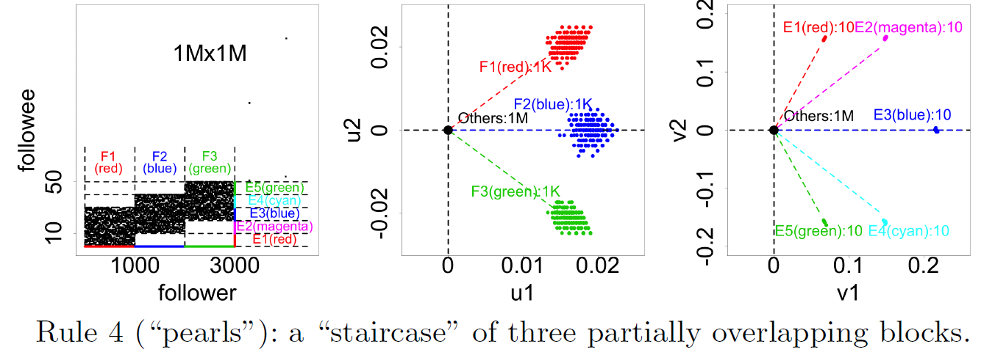
Lockstep and Spectral Subspace Plot
Case #4: ? lockstep
“?” “Pearls”
Adjacency Matrix
Spectral Subspace Plot
?

Slide 32
Lockstep and Spectral Subspace Plot
Case #4: overlapping lockstep
“Staircase” “Pearls”
Adjacency Matrix
Spectral Subspace Plot

Slide 33


Dataset
Tencent Weibo
117 million nodes (with profile and UGC data)
3.33 billion directed edges

Slide 34
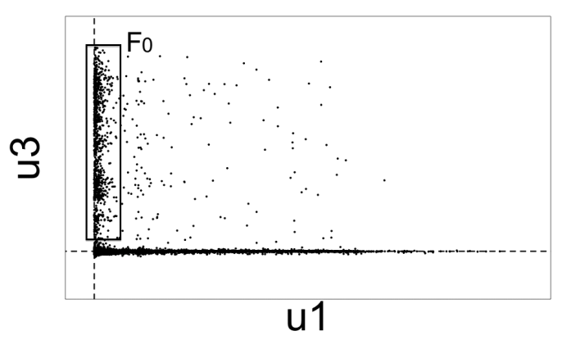
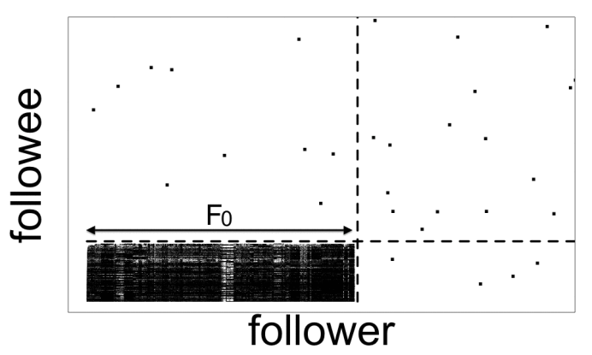
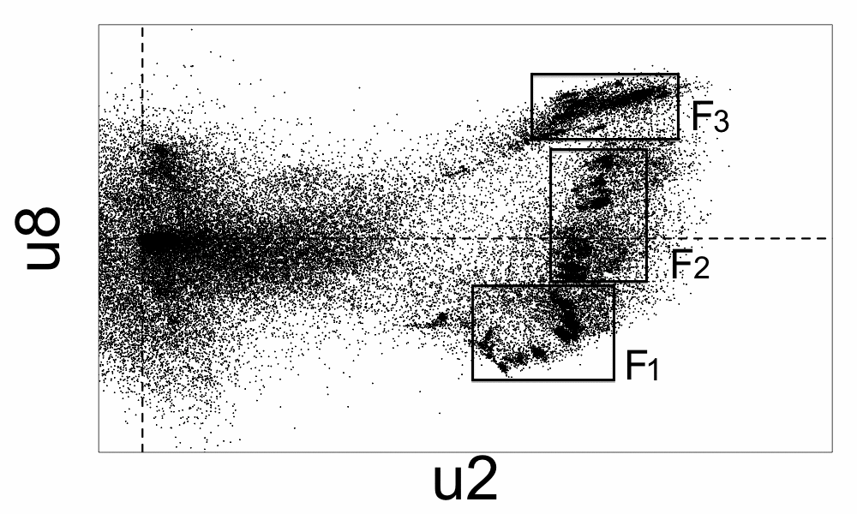
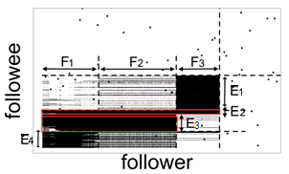
Real Data
“Rays”
“Block”
“Pearls”
“Staircase”

Slide 35
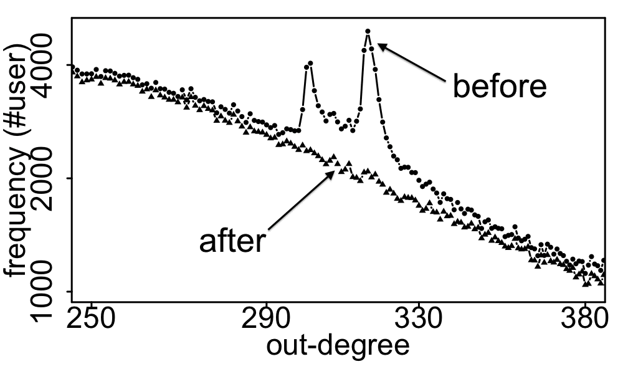
Real Data
Spikes on the out-degree distribution
×
×

Slide 36
CoreScope

Slide 37
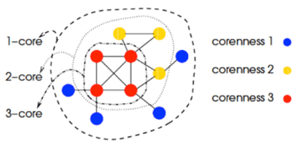
S4: k-core patterns - dfn
k-core (of a graph)
degeneracy (of a graph)
coreness (of a vertex)

Slide 38
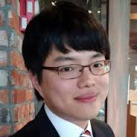
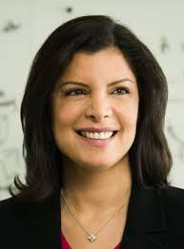
CoreScope: Graph Mining Using k-Core Analysis - Patterns, Anomalies, and Algorithms
ICDM’16
Kijung Shin, Tina Eliassi-Rad and CF

Slide 39
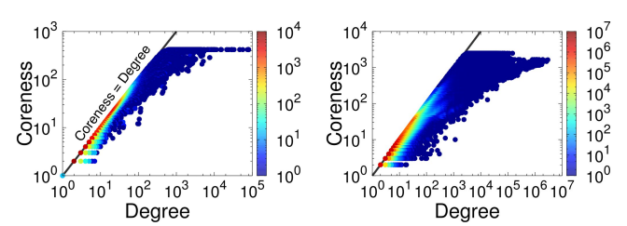
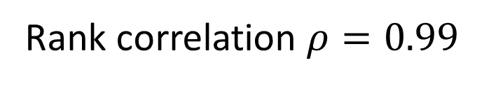
Mirror Pattern: Observation
coreness (of a vertex): maximum k such that the vertex belongs to the k-core
Definition: [Mirror Pattern] degree ~ coreness

Slide 40
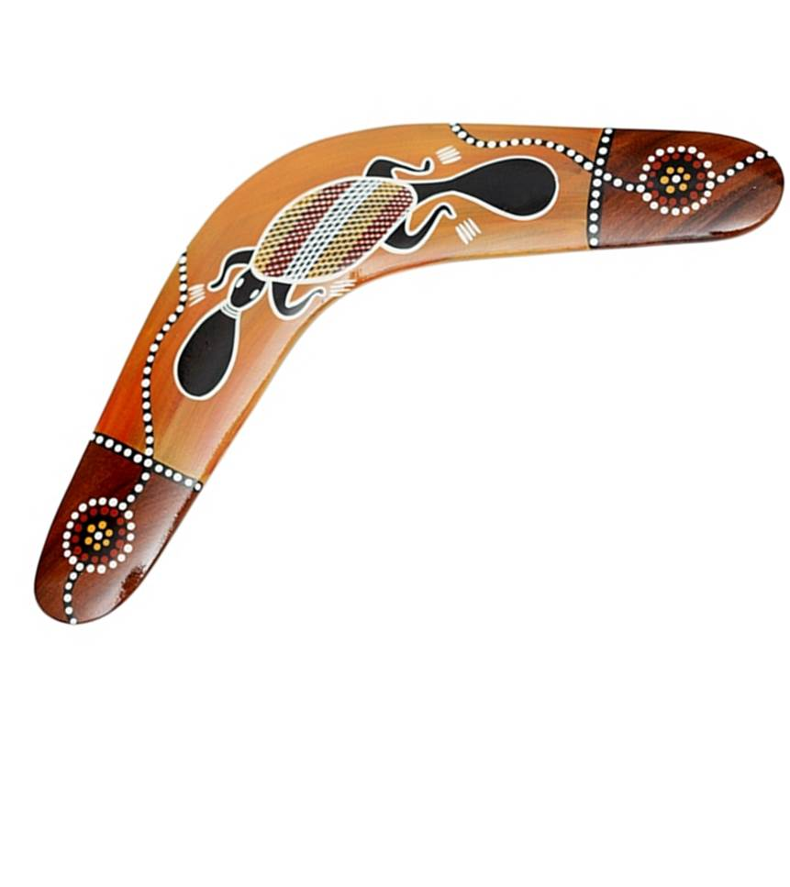
Mirror Pattern: Observation
coreness (of a vertex): maximum k such that the vertex belongs to the k-core
Definition: [Mirror Pattern] degree ~ coreness

Slide 41
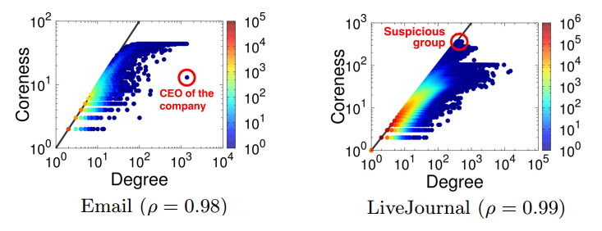
Mirror Pattern: Application
Exceptions are ‘strange’

Slide 42
Roadmap
Introduction – Motivation
Part#1: Patterns in graphs
Patterns
Anomaly / fraud detection
CopyCatch
Spectral methods (‘fBox’)
Belief Propagation
Part#2: time-evolving graphs; tensors
Conclusions

Slide 43
NetProbe

Slide 44

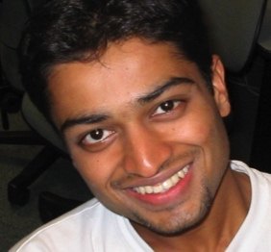
E-bay Fraud detection
w/ Polo Chau &
Shashank Pandit, CMU
[www’07]

Slide 45
E-bay Fraud detection

Slide 46
E-bay Fraud detection

Slide 47
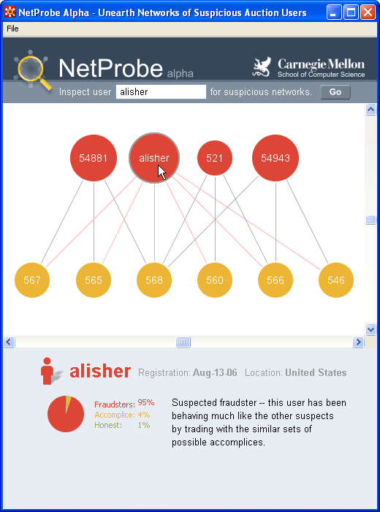
E-bay Fraud detection - NetProbe

Slide 48


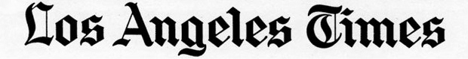
Popular press
And less desirable attention:
E-mail from ‘Belgium police’ (‘copy of your code?’)

Slide 49
Roadmap
Introduction – Motivation
Part#1: Patterns in graphs
Patterns
Anomaly / fraud detection
CopyCatch
Spectral methods (‘fBox’)
Belief Propagation; antivirus app
Part#2: time-evolving graphs; tensors
Conclusions

Slide 50
Polonium

Slide 51
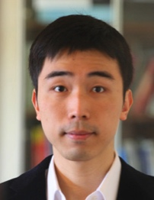
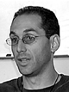



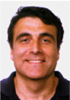
Polonium: Tera-Scale Graph Mining and Inference for Malware Detection
PATENT PENDING
SDM 2011, Mesa, Arizona
Polo Chau
Machine Learning Dept
Carey Nachenberg
Vice President & Fellow
Jeffrey Wilhelm
Principal Software Engineer
Adam Wright
Software Engineer
Prof. Christos Faloutsos
Computer Science Dept

Slide 52
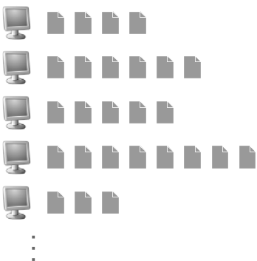
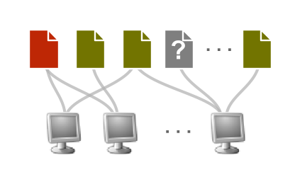
Polonium: The Data
Ç√
60+ terabytes of data anonymously contributed by participants of worldwide Norton Community Watch program
50+ million machines
900+ million executable files
Constructed a machine-file bipartite graph (0.2 TB+)
1 billion nodes (machines and files)
37 billion edges
Ç√
Ç√
Notes:
As of today, has grown to more than three times

Slide 53
Polonium: Key Ideas
Use Belief Propagation to propagate domain knowledge in machine-file graph to detect malware
Use “guilt-by-association” (i.e., homophily)
E.g., files that appear on machines with many bad files are more likely to be bad
Scalability: handles 37 billion-edge graph

Slide 54
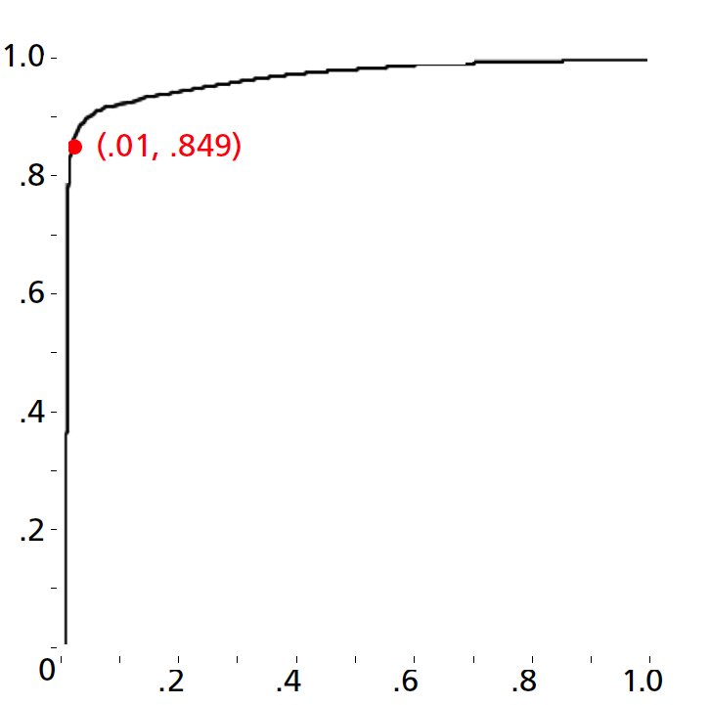
Polonium: One-Interaction Results
Ideal
84.9% True Positive Rate 1% False Positive Rate
True Positive Rate
% of malware correctly identified
False Positive Rate
% of non-malware wrongly labeled as malware
Notes:
for files reported by four or more machines

Slide 55
Roadmap
Introduction – Motivation
Part#1: Patterns in graphs
Patterns
Anomaly / fraud detection
CopyCatch
Spectral methods (‘fBox’)
Belief Propagation; financial fraud
Part#2: time-evolving graphs; tensors
Conclusions

Slide 56
SNARE

Slide 57
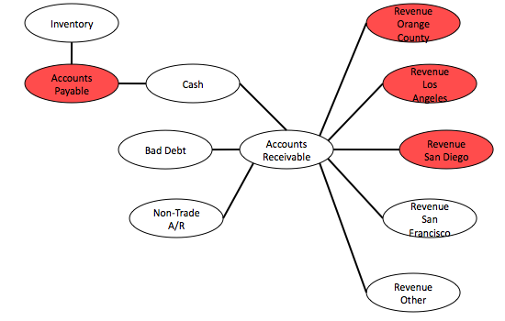
Network Effect Tools: SNARE
Some accounts are sort-of-suspicious – how to combine weak signals?
Before

Slide 58
Network Effect Tools: SNARE
A: Belief Propagation.
Before

Slide 59
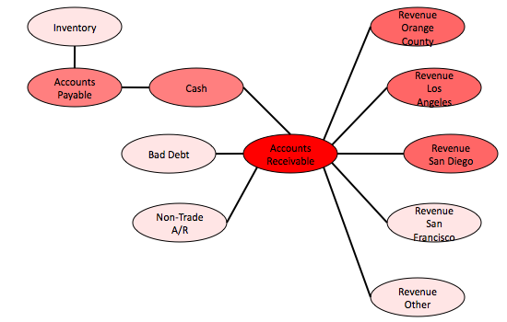
Network Effect Tools: SNARE
A: Belief Propagation.
Before
After
Mary McGlohon, Stephen Bay, Markus G. Anderle, David M. Steier, Christos Faloutsos: SNARE: a link analytic system for graph labeling and risk detection. KDD 2009: 1265-1274

Slide 60
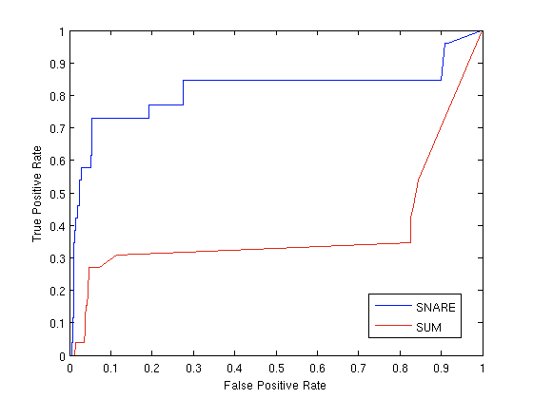
Network Effect Tools: SNARE
Produces improvement over simply using flags
Up to 6.5 lift
Improvement especially for low false positive rate
Results for accounts data (ROC Curve)
Ideal
SNARE
Baseline (flags only)
True positive rate
False positive rate

Slide 61
Network Effect Tools: SNARE
Accurate- Produces large improvement over simply using flags
Flexible- Can be applied to other domains
Scalable- One iteration BP runs in linear time (# edges)
Robust- Works on large range of parameters

Slide 62
Roadmap
Introduction – Motivation
Part#1: Patterns in graphs
Patterns
Anomaly / fraud detection
CopyCatch
Spectral methods (‘fBox’)
Belief Propagation; fast computation & unification
Part#2: time-evolving graphs; tensors
Conclusions

Slide 63
Belief Propagation
FaBP etc

Slide 64
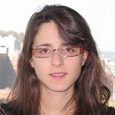
Unifying Guilt-by-Association Approaches: Theorems and Fast Algorithms
Danai Koutra
U Kang
Hsing-Kuo Kenneth Pao
Tai-You Ke
Duen Horng (Polo) Chau
Christos Faloutsos
ECML PKDD, 5-9 September 2011, Athens, Greece
Notes:
Work in collaboration with National Taiwan University

Slide 65

Problem Definition: GBA techniques
?
Given: Graph; &
few labeled nodes
Find: labels of rest
(assuming network effects)
?
?
?
Notes:
Classification problem where we assume that neighboring nodes are related
Network effects – birds of a feather flock together

Slide 66

Are they related?
RWR (Random Walk with Restarts)
google’s pageRank (‘if my friends are important, I’m important, too’)
SSL (Semi-supervised learning)
minimize the differences among neighbors
BP (Belief propagation)
send messages to neighbors, on what you believe about them

Slide 67
Are they related?
YES!
RWR (Random Walk with Restarts)
google’s pageRank (‘if my friends are important, I’m important, too’)
SSL (Semi-supervised learning)
minimize the differences among neighbors
BP (Belief propagation)
send messages to neighbors, on what you believe about them

Slide 68
Correspondence of Methods
Method | Matrix |  | Unknown |  | known
RWR | [I – c AD⁻¹] | × | x | = | (1-c)y
SSL | [I + a(D - A)] | × | x | = | y
FABP | [I + a D - c’A] | × | b_{h} | = | φ_{h}
1
1
1
d1
d2
d3
0 1 0
1 0 1
0 1 0
?
0
1
1
adjacency matrix
final labels/ beliefs
prior labels/ beliefs

Slide 69


Results: Scalability
runtime (min)
# of edges (Kronecker graphs)
FABP is linear on the number of edges.
Notes:
Kronecker graphs

Slide 70

Results: Parallelism
% accuracy
runtime (min)
FABP ~2x faster
& wins/ties on accuracy.

Slide 71
ZooBP

Slide 72

Problem: e-commerce ratings fraud
Given a heterogeneous graph on users, products, sellers and positive/negative ratings with “seed labels”
Find the top k most fraudulent users, products and sellers

Slide 73



Problem: e-commerce ratings fraud
Given a heterogeneous graph on users, products, sellers and positive/negative ratings with “seed labels”
Find the top k most fraudulent users, products and sellers
Dhivya Eswaran, Stephan Günnemann, Christos Faloutsos, “ZooBP: Belief Propagation for Heterogeneous Networks”, VLDB 2017

Slide 74

Problem: e-commerce ratings fraud
Dhivya Eswaran, Stephan Günnemann, Christos Faloutsos, “ZooBP: Belief Propagation for Heterogeneous Networks”, VLDB 2017

Slide 75


ZooBP: features
Fast; convergence guarantees.
Near-perfect accuracy
linear in graph size
Dhivya Eswaran, Stephan Günnemann, Christos Faloutsos, “ZooBP: Belief Propagation for Heterogeneous Networks”, VLDB 2017

Slide 76

ZooBP in the real world
Near 100% precision on top 300 users (Flipkart)
Flagged users: suspicious
400 ratings in 1 sec
5000 good ratings and no bad ratings
Dhivya Eswaran, Stephan Günnemann, Christos Faloutsos, “ZooBP: Belief Propagation for Heterogeneous Networks”, VLDB 2017

Slide 77


Summary of Part#1
*many* patterns in real graphs
Power-laws everywhere
Gaussian trap
Avg << Max
Long (and growing) list of tools for anomaly/fraud detection
Patterns anomalies

Slide 78
Roadmap
Introduction – Motivation
Part#1: Patterns in graphs
Part#2: time-evolving graphs; tensors
P2.1: time-evolving graphs
[P2.2: with side information (‘coupled’ M.T.F.)
Speed]
Conclusions

Slide 79
Part 2:
Time evolving
graphs; tensors

Slide 80
Tensors
For patterns &
anomalies

Slide 81
Graphs over time -> tensors!
Problem #2.1:
Given who calls whom, and when
Find patterns / anomalies
johnson
smith

Slide 82
Graphs over time -> tensors!
Problem #2.1:
Given who calls whom, and when
Find patterns / anomalies

Slide 83
Graphs over time -> tensors!
Problem #2.1:
Given who calls whom, and when
Find patterns / anomalies
Tue
Mon

Slide 84
Graphs over time -> tensors!
Problem #2.1:
Given who calls whom, and when
Find patterns / anomalies
time
caller
callee

Slide 85
Graphs over time -> tensors!
Problem #2.1’:
Given author-keyword-date
Find patterns / anomalies
date
MANY more settings,
with >2 ‘modes’
author
keyword

Slide 86
Graphs over time -> tensors!
Problem #2.1’’:
Given subject – verb – object facts
Find patterns / anomalies
verb
MANY more settings,
with >2 ‘modes’
subject
object

Slide 87
Graphs over time -> tensors!
Problem #2.1’’’:
Given <triplets>
Find patterns / anomalies
mode3
MANY more settings,
with >2 ‘modes’
(and 4, 5, etc modes)
mode1
mode2

Slide 88


Answer to both: tensor factorization
Recall: (SVD) matrix factorization: finds blocks
‘meat-eaters’
‘steaks’
‘vegetarians’
‘plants’
‘kids’
‘cookies’
M
products
N
users
+
+
~

Slide 89
Answer to both: tensor factorization
PARAFAC decomposition
politicians
artists
athletes
verb
subject
+
+
=
object

Slide 90
Answer: tensor factorization
PARAFAC decomposition
Results for who-calls-whom-when
4M x 15 days
??
??
??
time
caller
+
+
=
callee

Slide 91



Anomaly detection in time-evolving graphs
=
Anomalous communities in phone call data:
European country, 4M clients, data over 2 weeks
~200 calls to EACH receiver on EACH day!
1 caller
5 receivers
4 days of activity

Slide 92
Anomaly detection in time-evolving graphs
=
Anomalous communities in phone call data:
European country, 4M clients, data over 2 weeks
~200 calls to EACH receiver on EACH day!
1 caller
5 receivers
4 days of activity

Slide 93


Anomaly detection in time-evolving graphs
=
Anomalous communities in phone call data:
European country, 4M clients, data over 2 weeks
~200 calls to EACH receiver on EACH day!
Miguel Araujo, Spiros Papadimitriou, Stephan Günnemann, Christos Faloutsos, Prithwish Basu, Ananthram Swami,
Evangelos Papalexakis, Danai Koutra. Com2: Fast Automatic Discovery of Temporal (Comet) Communities. PAKDD 2014, Tainan, Taiwan.

Slide 94
Roadmap
Introduction – Motivation
Part#1: Patterns in graphs
Part#2: time-evolving graphs; tensors
P2.1: Discoveries @ phonecall network
[P2.2: Discoveries in neuro-semantics
Speed]
Conclusions

Slide 95
Part 2: Conclusions
Time-evolving / heterogeneous graphs -> tensors
PARAFAC finds patterns
(GigaTensor/HaTen2 -> fast & scalable)
=

Slide 96
Roadmap
Introduction – Motivation
Why study (big) graphs?
Part#1: Patterns in graphs
Part#2: time-evolving graphs; tensors
Acknowledgements and Conclusions

Slide 97








Thanks
Disclaimer: All opinions are mine; not necessarily reflecting the opinions of the funding agencies
Thanks to: NSF IIS-0705359, IIS-0534205,
CTA-INARC; Yahoo (M45), LLNL, IBM, SPRINT, Google, INTEL, HP, iLab

Slide 98









Cast
Akoglu,
Leman
Araujo,
Miguel
Beutel,
Alex
Chau,
Polo
Hooi,
Bryan
Koutra,
Danai
Papalexakis,
Vagelis
Shah,
Neil
Kang, U
Song,
Hyun Ah

Slide 99

Cast
Akoglu,
Leman
Araujo,
Miguel
Beutel,
Alex
Chau,
Polo
Eswaran,
Dhivya
Hooi,
Bryan
Kang, U
Koutra,
Danai
Papalexakis,
Vagelis
Shah,
Neil
Shin,
Kijung
Song,
Hyun Ah

Slide 100




CONCLUSION#1 – Big data
Patterns Anomalies
Large datasets reveal patterns/outliers that are invisible otherwise

Slide 101
CONCLUSION#2 – tensors
powerful tool
=
1 caller
5 receivers
4 days of activity

Slide 102

References
D. Chakrabarti, C. Faloutsos: Graph Mining – Laws, Tools and Case Studies, Morgan Claypool 2012
http://www.morganclaypool.com/doi/abs/10.2200/S00449ED1V01Y201209DMK006

Slide 103


TAKE HOME MESSAGE:
Cross-disciplinarity
=

